Slide 1
Making Your M&E
EASIER AND BETTER
Notes:
This presentation was prepared by People in Need (PIN) to help you with presenting IndiKit to your colleagues and partner organizations. Below each slide you will find suggestions on what can you say about the given slide.
“In this 10 minute presentation I would like to introduce you to a M&E tool called IndiKit and explain how it can help you with your work.”

Slide 2
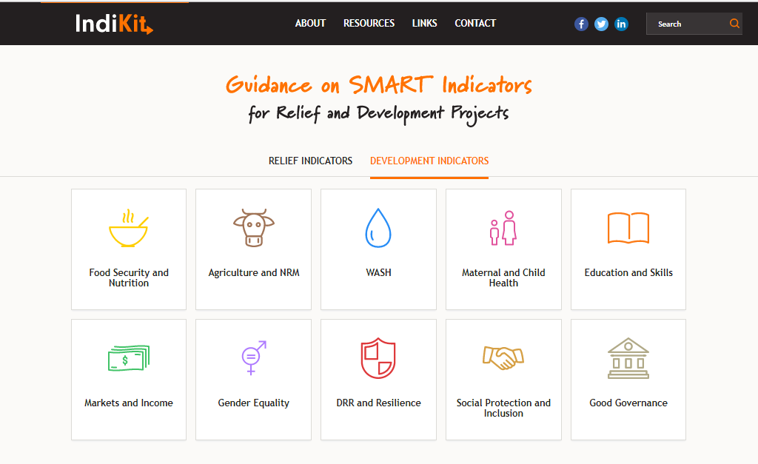
WHAT is www.indikit.net about?
Notes:
Ask people: “Does anyone know IndiKit?” If someone knows IndiKit, ask him/her: “What is this tool about?”

Slide 3
on-line guidance on the use of hundreds of relief & development indicators
IndiKit is here to help aid workers from various organizations and countries:
save time on M&E-related tasks
increase the quality of their M&E
developed by People in Need with the support of other NGOs and experts
based on existing guidance materials and field experience of NGOs/UN
Wikipedia’s principle – every user can propose changes or new content
launched in June 2017, visited by 200 – 500 users per day
Notes:
“IndiKit provides practical, easy-to-understand guidance on the use of the most commonly used project-level indicators across over 10 humanitarian and development sectors.
IndiKit’s main aim is to 1) save aid workers’ time and 2) help them improve the quality of their M&E.
IndiKit was developed by People in Need based on reviewing over 800 of existing resources and on engaging dozens of M&E and sectoral specialists. It follows the standards and guidance provided by the Sphere Standards and various UN agencies.
IndiKit is here for everyone, for all relief and development organizations from all countries. Everyone can also propose changes or new content – so far we received feedback from people working for over 40 different organizations.
IndiKit operates since mid-2017, users are from the entire world.” (next click shows map)

Slide 4
Notes:
“Most of IndiKit users come from Eastern Africa, South Asia, US & UK and Middle East. IndiKit was visited by people from nearly all countries in the world.”

Slide 5
HOW www.indikit.net works?
Notes:
“Now I would like to show you briefly how IndiKit works.”

Slide 6
Notes:
Go to www.indikit.net (if you’re in Slide Show mode, you can just click on the picture of IndiKit’s homepage, it serves as a link). Before you start the presentation, make sure that you’re connected to Internet.
Once you get to the homepage, show briefly the following:
Two layers at homepage – one with development, second with relief indicators
2) In the Development section, click on “Food Security and Nutrition”, go to HDDS indicator (as an example) and show that for each indicator people can find:
- the first key information is the indicator’s phrasing in English and French
- what is the purpose of the indicator – what is it good for
- guidance on how to collect the data required for the indicator
- important recommendations on what to be careful about, what to ensure, etc. when using the indicator
- additional resources on using the indicator
- if people have ideas on what could be described in a better way or what is missing, they can propose changes by using the form at the bottom of the site”
Say that at the “Resources” site they can find sample size calculator, brief M&E guides, checklists, links to additional resources. At the “Links” site are links to hundreds of additional indicators used by various donors, institutions, etc. Show briefly both sites.
4) You can conclude it by saying: “With 2-3 clicks you can get most of the information you need – it is very easy.”

Slide 7
WHO should use IndiKit?
Notes:
“Let’s now have a look at who is expected to use IndiKit.”

Slide 8
IndiKit should be used by:
people who design M&E systems and surveys
M&E Officers, Project / Programme Managers (PMs) …
people who develop new logframes
Heads of Programmes, PMs, Desk Officers, Grants Development Managers, technical advisors …
It is very easy to use IndiKit – anyone can do it!
Notes:
“IndiKit should be used by all staff who prepare project log frames, M&E systems and M&E surveys, this means M&E Officers, Project/Program Managers, HoPs, Desk Officers and other people who write or comment on proposals and M&E tasks.
As you could see, IndiKit is designed in a very user-friendly way, so it is very easy to use it.”

Slide 9
WHY should you use IndiKit?
Notes:
Ask people: „Why do you think that it is a good idea to use IndiKit?“ (let people list a few reasons, highlight the most valid opinions)

Slide 10
you save your (and other people’s) time
no need to invent many new indicators – just choose them from IndiKit
save time in addressing people’s comments on your logframe indicators
reduce the time you spend commenting on mistakes in other people’s logframes
spend less time designing M&E surveys by using IndiKit’s guidance
you do your work to a better quality
donors prefer logframes with good indicators → better funding chances
good indicators makes conducting surveys much easier + they inform you better on what your team’s work has actually achieved
Notes:
“It is a good idea to use IndiKit because it 1) can save lots of your time; and 2) it helps you with preparing logframes / M&E in a better quality.”

Slide 11
WHEN can IndiKit help you?
Notes:
Ask people: “In your opinion, in which situations can IndiKit save lots of your time?”

Slide 12
Use IndiKit when you:
develop a logframe
prepare your survey questionnaire
design your survey methodology
implement baseline/endline/other survey
Notes:
IndiKit will help you when you:
1) … develop logframe and need ideas for good indicators or when you are not sure how to correctly phrase an indicator
2) … prepare baseline/endline and you are not sure how to collect data required for your logframe indicators (e.g. what questions to ask, how to analyze the data)
3) … design the methodology for your survey and need help with calculating sample size, choosing the right sampling methodology, etc.
4) … prepare or implement baseline/endline or other survey and need good checklists that help you keep all important things in mind

Slide 13
How Can YOU Get Involved?
Notes:
“As I mentioned earlier, IndiKit is here for everyone – everyone can use it but everyone can also support it. The more people get involved in IndiKit, the better support it will provide. Let me show you a few examples of how can you get involved.”

Slide 14
Use IndiKit ☺
Notes:
“The single best way how you can support IndiKit’s aim is when you use it in your everyday work. If you supervise other people who should use IndiKit, encourage them to do so. It will save you lots of time and result in an even better quality of your work.”

Slide 15
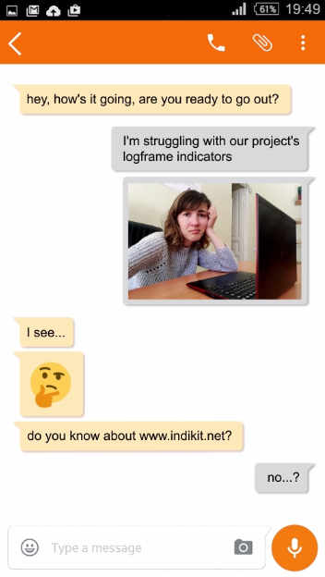
Promote IndiKit
Notes:
(DELETE FROM THIS SLIDE ANY MATERIALS THAT MIGHT NOT BE CULTURALLY RELEVANT, such as the “African” cartoon if you’re in an Asian country or the WhatsApp screenshot if you’re in a Muslim country.)
“IndiKit has lots of nice materials such as a cartoon, banners, video, articles … and it will be great if you can use them for promoting IndiKit among your colleagues and partners.”

Slide 16
How can you promote IndiKit?
post banners with link to IndiKit on your Facebook or LinkedIn account and ask people to share them
send e-mail to your partner organizations introducing IndiKit
if you’re on a relevant mailing list, let its members know about IndiKit
present IndiKit at a relevant coordination meeting
mention it in the M&E sections of your new project proposals
Notes:
“There are several ways how you can promote IndiKit and none of them will take much of your time:
If you go to IndiKit’s section “Resources” and scroll down (show this process), you can download several banners, cartoon and video promoting IndiKit and post them on your Facebook or LinkedIn. Always also ask people to share your post!
You can send to your partner NGOs an e-mail informing them about IndiKit and again, ask them to share it with their colleagues and partners.
3) You can also send a similar e-mail to any mailing list you are a member of (if no one has done it before you).
If you go to a meeting that is attended by many relief/development actors (e.g. a cluster meeting, working group meeting, etc.) you can ask its coordinator whether you can take 5 minutes to present IndiKit’s website. Since IndiKit is popular, it is very likely that people will like your presentation.
IndiKit is an attractive and useful tool, so it can help your project proposal if a donor knows that you will use IndiKit’s guidance. You can let them know my including in your proposal’s M&E section a brief text about IndiKit.” (in this presentation is an example – see below; tell people that you’ll send it to them and do it then)
To ensure that the project’s baseline and endline surveys are designed and conducted to the maximum quality, the project team will take advantage of the M&E support available at www.indikit.net. IndiKit provides step-by-step guidance on collecting and analysing data required for the most common project indicators. At the same time, its practical Rapid Guides help managers to ensure the required quality of the surveys’ methodology.

Slide 17
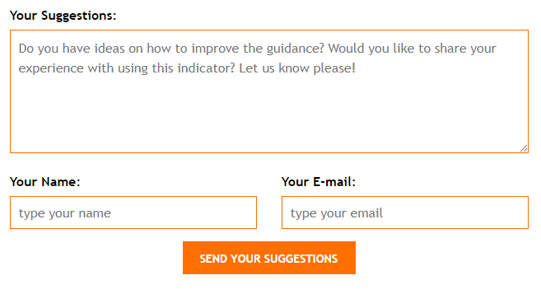
Make IndiKit Better – Propose Improvements
Notes:
“If you come across any guidance that is not clear or you know how you could improve – for example, by sharing your experience with using the indicator – then fill in the form at the bottom of each indicator page. The team behind IndiKit will then use your feedback to improve IndiKit’s content.”

